Slide 1
CAMERA CALIBRATION

Slide 2
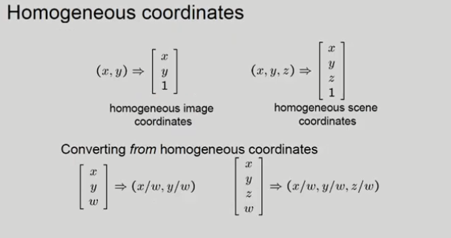

Slide 3
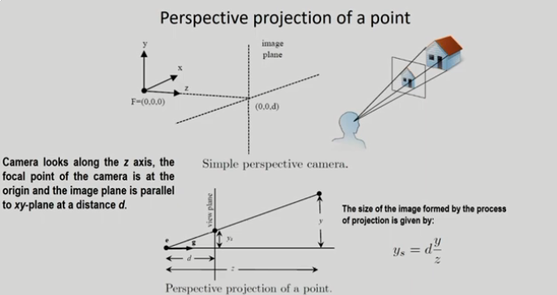

Slide 4
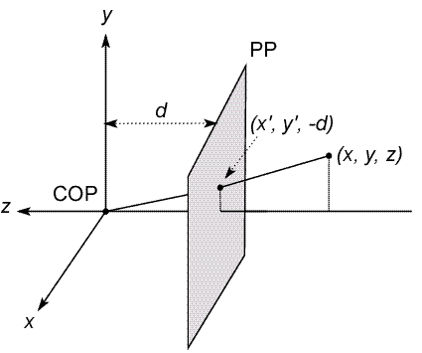
MODELING PROJECTION
The coordinate system
We will use the pin-hole model as an approximation
Put the optical center (Center Of Projection) at the origin
Put the image plane (Projection Plane) in front of the COP
Why?-This configuration naturally produces a "right-side up" image on the projection plane, eliminating the need for additional image flipping operations
The camera looks down the negative z axis
we need this if we want right-handed-coordinates

Slide 5
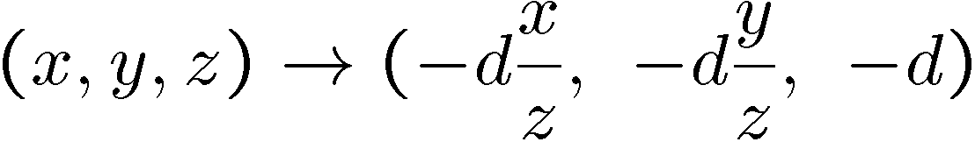
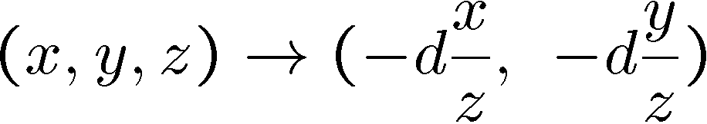
MODELING PROJECTION
Projection equations
Compute intersection with PP of ray from (x,y,z) to COP
Derived using similar triangles
We get the projection by throwing out the last coordinate:

Slide 6
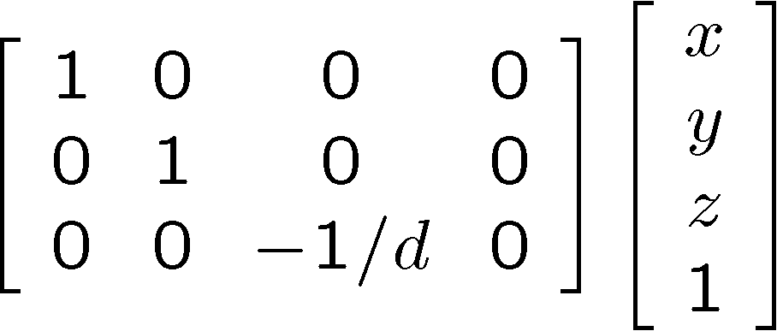
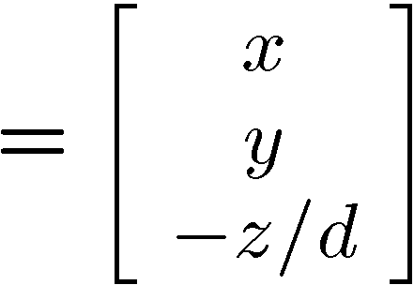
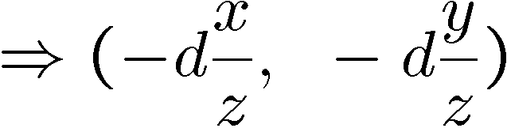
PERSPECTIVE PROJECTION
Projection is a matrix multiply using homogeneous coordinates:
divide by third coordinate
This is known as perspective projection
The matrix is the projection matrix

Slide 7
PERSPECTIVE PROJECTION EXAMPLE
1. Object point at (10, 6, 4), d=2
2. Object point at (25, 15, 10)
Perspective projection is not 1-to-1!

Slide 8
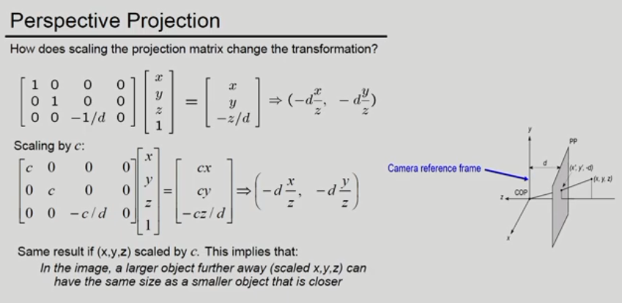

Slide 9
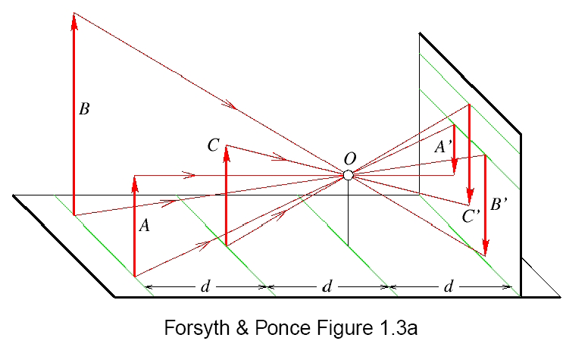
Distant objects are smaller
PERSPECTIVE PROJECTION
Size is inversely proportional to distance.

Slide 10
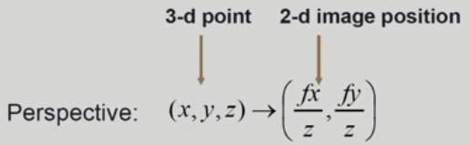
PERSPECTIVE PROJECTION
In a perspective projection matrix, "f" (focal length) and "-d" (negative depth) are essentially the same value because they represent the distance from the viewpoint to the near clipping plane

Slide 11
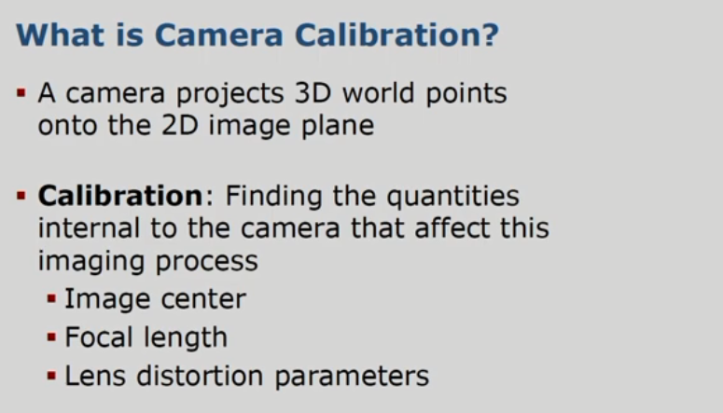
INTRINSIC PARAMETERS

Slide 12
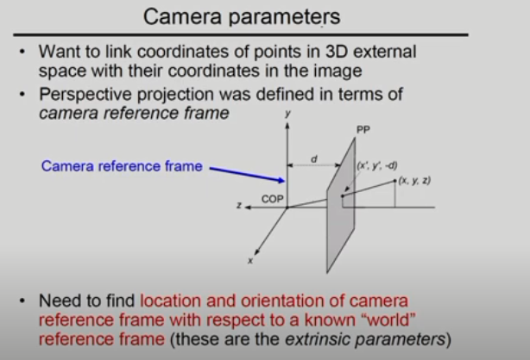

Slide 13
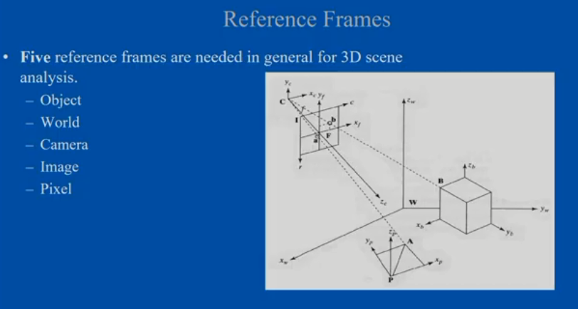
CAMERA CALIBRATION

Slide 14
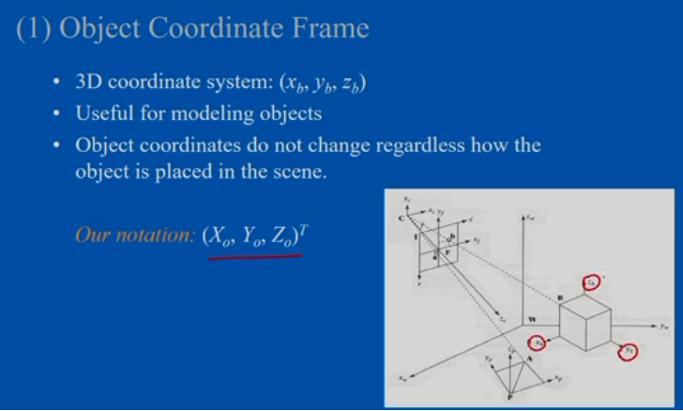
CAMERA CALIBRATION

Slide 15
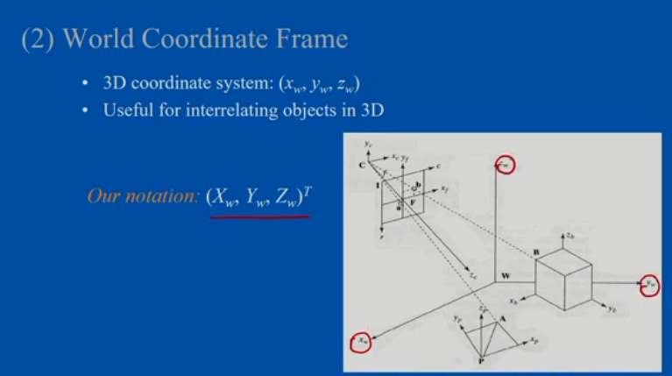
CAMERA CALIBRATION

Slide 16
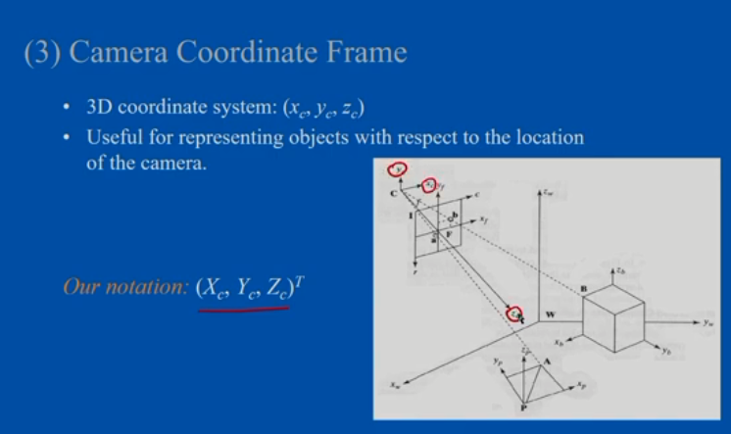
CAMERA CALIBRATION

Slide 17
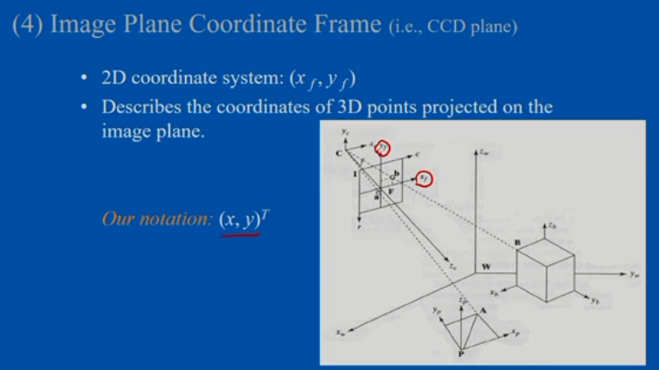
CAMERA CALIBRATION

Slide 18
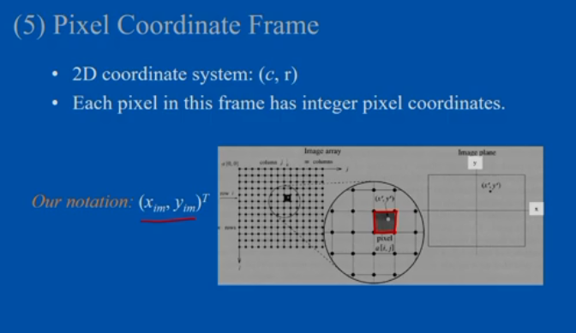
CAMERA CALIBRATION

Slide 19
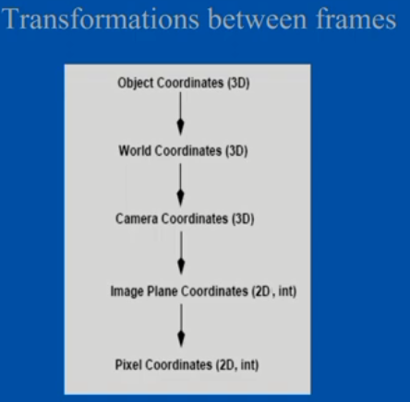
CAMERA CALIBRATION
Extrinsic Camera Parameters
Intrinsic Camera Parameters

Slide 20
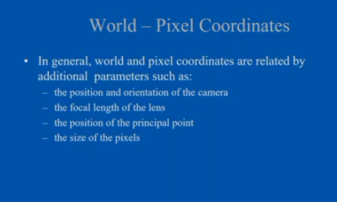
CAMERA CALIBRATION

Slide 21
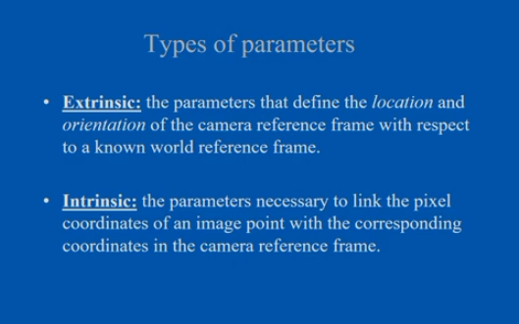
CAMERA CALIBRATION

Slide 22
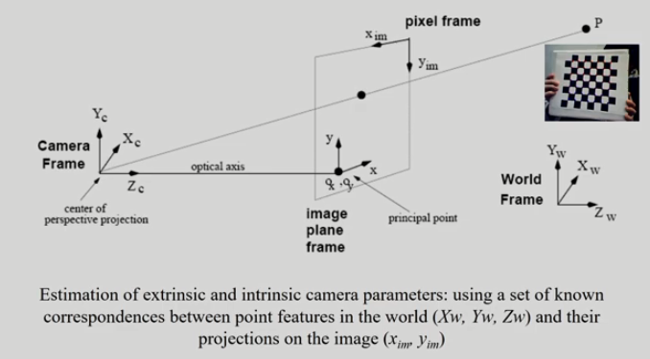
CAMERA CALIBRATION

Slide 23
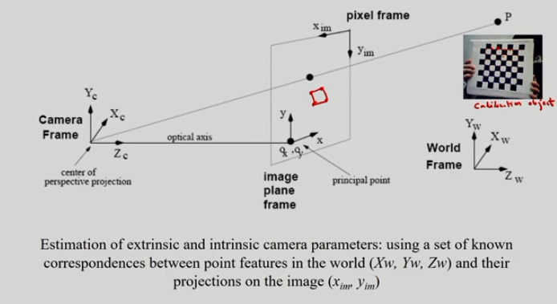
CAMERA CALIBRATION

Slide 24
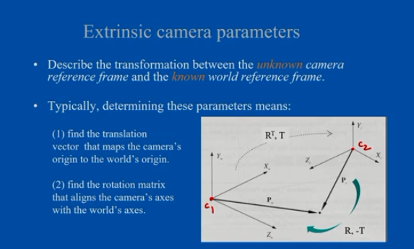
CAMERA CALIBRATION

Slide 25
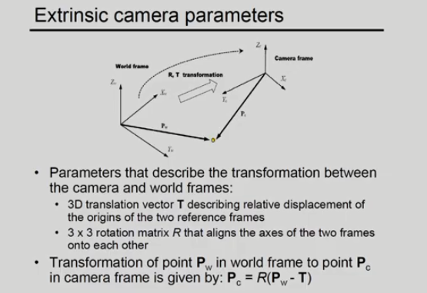
CAMERA CALIBRATION

Slide 26
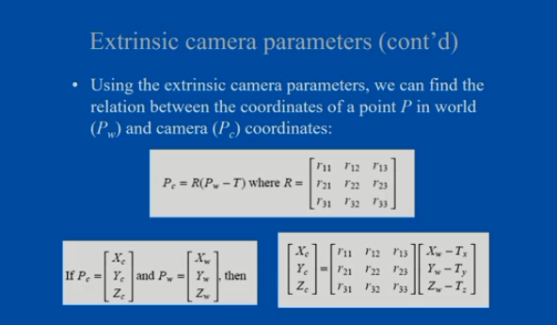
CAMERA CALIBRATION

Slide 27
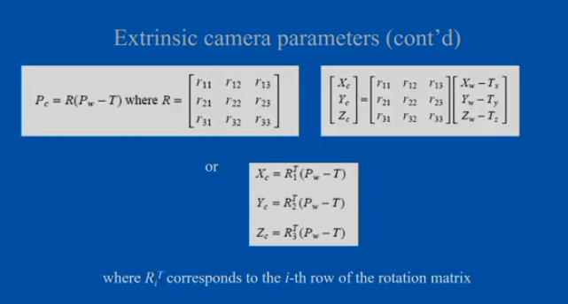
CAMERA CALIBRATION

Slide 28
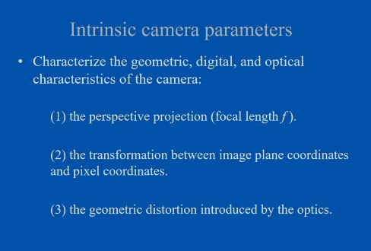
CAMERA CALIBRATION

Slide 29
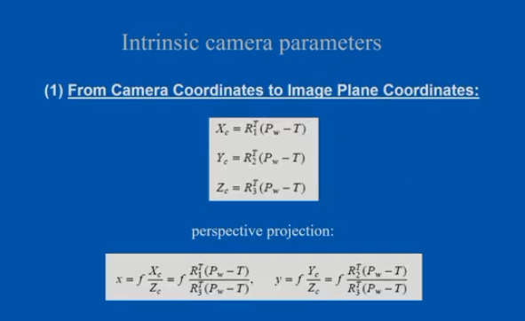
CAMERA CALIBRATION

Slide 30
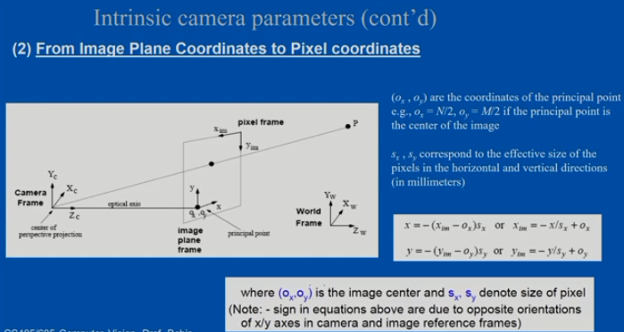
CAMERA CALIBRATION

Slide 31
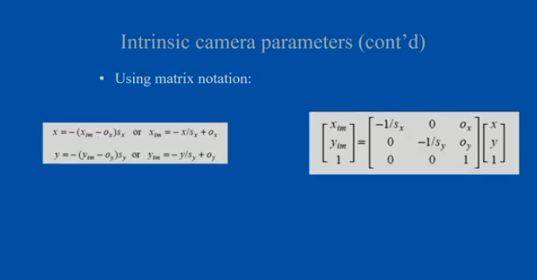
CAMERA CALIBRATION

Slide 32
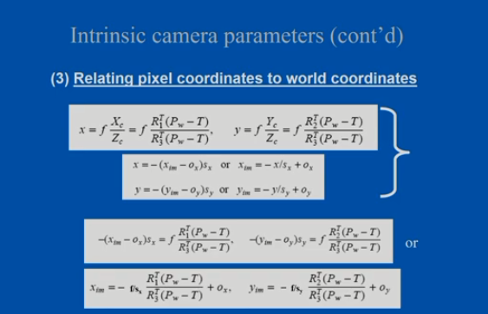
CAMERA CALIBRATION

Slide 33
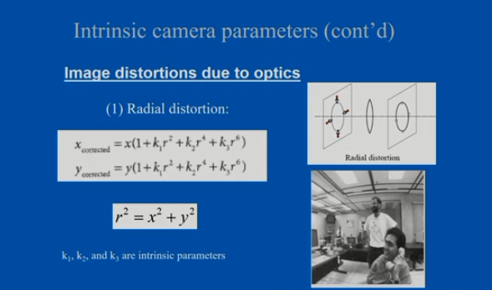
CAMERA CALIBRATION

Slide 34
CAMERA CALIBRATION
The radial distortion equation is obtained by mathematically modeling the phenomenon where light rays bend more near the edges of a lens than at its center, resulting in a distorted image; it typically takes the form of a polynomial equation where the distortion is expressed as a function of the distance from the image center (r), with coefficients (k1, k2, etc.) representing the degree of distortion, allowing for different levels of curvature depending on the lens design: distorted_coordinate = original_coordinate * (1 + k1 * r^2 + k2 * r^4 + ...)
r":
Represents the radial distance from the image center, calculated as the square root of the sum of squared differences between the pixel coordinates and the center point (x0, y0).
"k1, k2, ...":
These are the radial distortion coefficients; positive values indicate pincushion distortion (lines curve inwards), while negative values indicate barrel distortion (lines curve outwards).
Polynomial form:
The equation is often expressed as a polynomial with increasing powers of r to capture more complex distortion patterns.

Slide 35
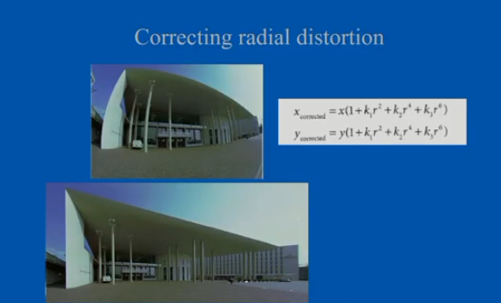
CAMERA CALIBRATION

Slide 36
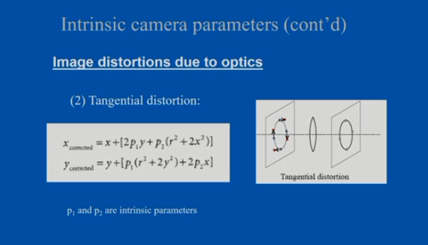
CAMERA CALIBRATION

Slide 37
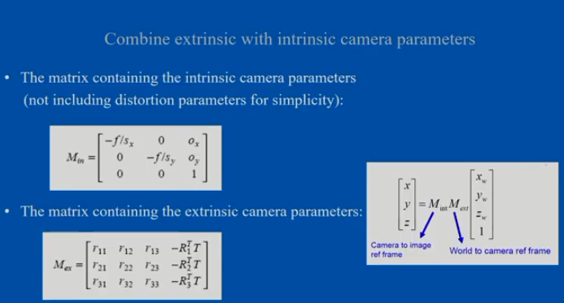
CAMERA CALIBRATION

Slide 38
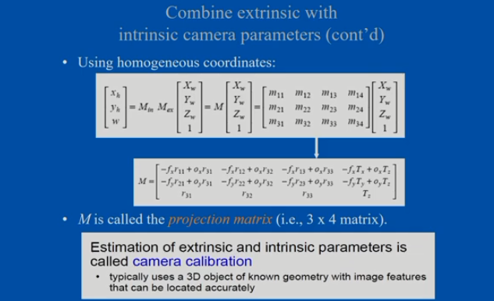
CAMERA CALIBRATION
f_{x}=f/s_{x}
f_{y}=f/s_{y}

Slide 39
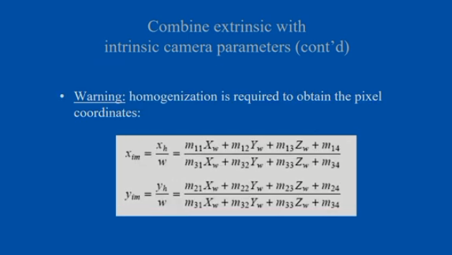
CAMERA CALIBRATION

Slide 40
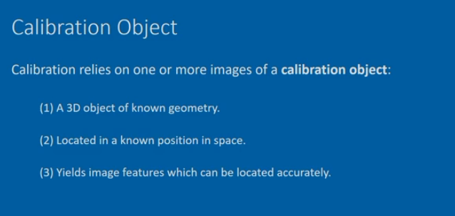
CAMERA CALIBRATION

Slide 41
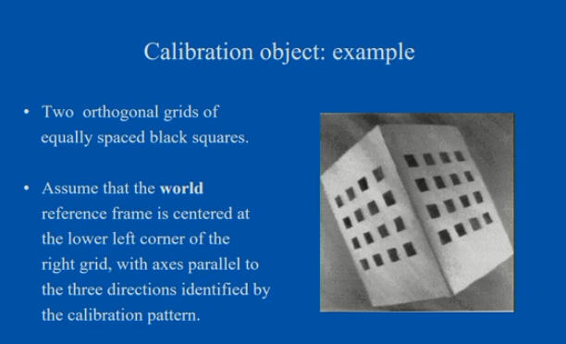
CAMERA CALIBRATION

Slide 42
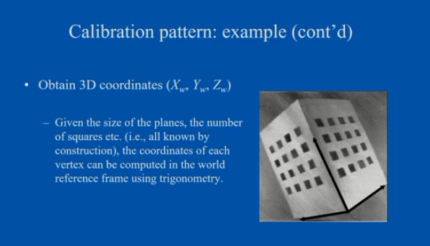
CAMERA CALIBRATION

Slide 43
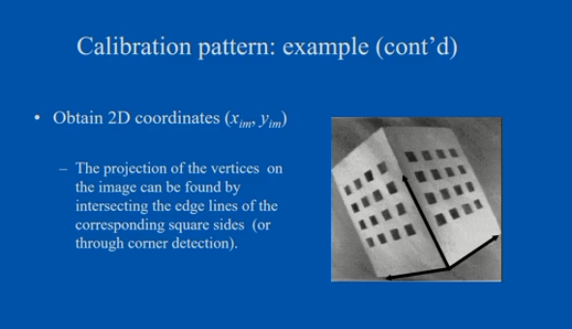
CAMERA CALIBRATION

Slide 44
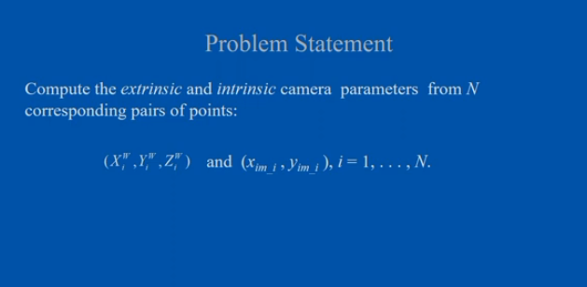
CAMERA CALIBRATION

Slide 45
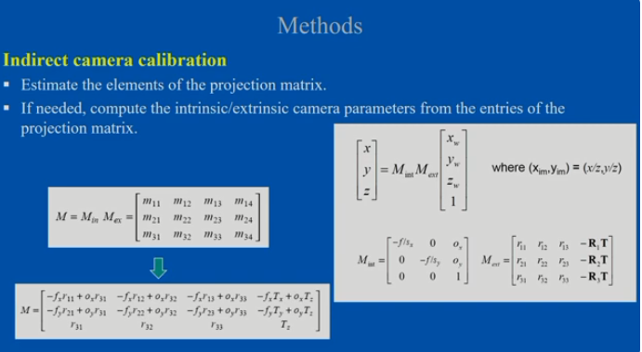
CAMERA CALIBRATION

Slide 46
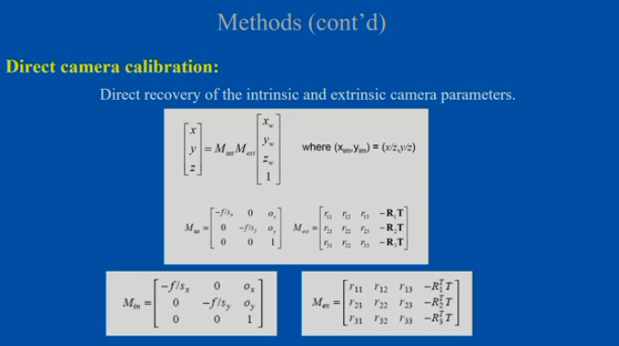
CAMERA CALIBRATION

Slide 47
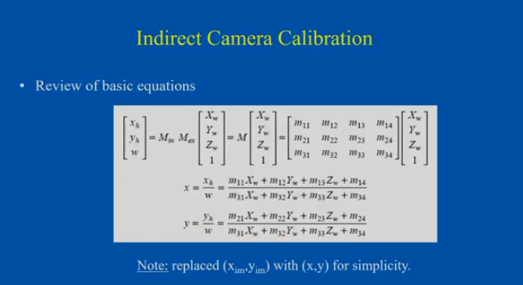
CAMERA CALIBRATION

Slide 48
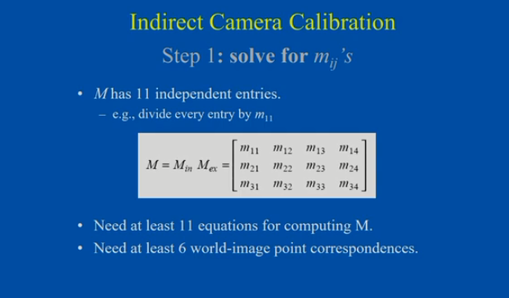
CAMERA CALIBRATION

Slide 49
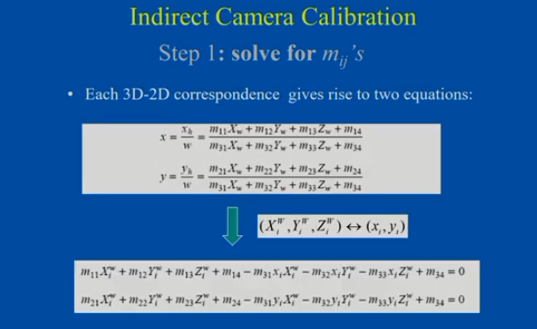
CAMERA CALIBRATION

Slide 50
(Method 1) Step 1: solve for m_{ij}’s
CAMERA CALIBRATION
This leads to a homogeneous system of equations:
N x 12 matrix

Slide 51
(Method 1) Step 1: solve for m_{ij}’s
CAMERA CALIBRATION

Slide 52
(Method 1) Step 2: find intrinsic/extrinsic parameters
CAMERA CALIBRATION

Slide 53
(Method 1) Step 2: find intrinsic/extrinsic parameters
CAMERA CALIBRATION
Let’s define the following vectors:

Slide 54
CAMERA CALIBRATION
(Method 1) Step 2: find intrinsic/extrinsic parameters
The solutions are as follows:
The rest parameters are easily computed ....

Slide 55
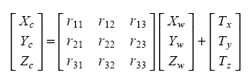
Method 2: Direct Camera Calibration
CAMERA CALIBRATION
Review of basic equations
From world coordinates to camera coordinates
For simplicity, we will replace -T’ with T
Warning: this is NOT the same T as before!
P_{c}=RP_{w}+T

Slide 56

Method 2: Direct Camera Calibration (cont’d)
CAMERA CALIBRATION
Review of basic equations
From camera coordinates to pixel coordinates:
Relating world coordinates to pixel coordinates:

Slide 57
Method 2: Direct Parameter Calibration
CAMERA CALIBRATION
Intrinsic parameters
Intrinsic parameters f, s_{x}, s_{y}, o_{x}, and o_{y} are not independent.
Define the following four independent parameters:

Slide 58
Method 2: Main Steps
CAMERA CALIBRATION
(1) Assuming that o_{x} and o_{y} are known, estimate all other parameters.
(2) Estimate o_{x} and o_{y}

Slide 59

(Method 2) Step 1: estimate f _{x ,} α, R, and T
CAMERA CALIBRATION
To simplify notation, set (x_{im}- o_{x} , y_{im}- o_{y}) = (x, y)
Combining the equations above (i.e., same denominator), we have:

Slide 60
(Method 2) Step 1: estimate f _{x ,} α, R, and T (cont’d)
CAMERA CALIBRATION
Each pair of corresponding points must satisfy the previous equation:
divide by f _{y} and re-arrange terms:

Slide 61
(Method 2) Step 1: estimate f _{x ,} α, R, and T (cont’d)
CAMERA CALIBRATION
we obtain the following equation:
where

Slide 62
(Method 2) Step 1: estimate f _{x ,} α, R, and T (cont’d)
CAMERA CALIBRATION
Assuming N correspondences leads to a homogeneous system :
N x 8 matrix

Slide 63
(Method 2) Step 1: estimate f _{x ,} α, R, and T (cont’d)
CAMERA CALIBRATION

Slide 64
(Method 2) Step 1: estimate f _{x ,} α, R, and T (cont’d)
CAMERA CALIBRATION
Determine α and | γ |

Slide 65

(Method 2) Step 1: estimate f _{x ,} α, R, and T (cont’d)
CAMERA CALIBRATION
Determine r₂₁, r₂₂, r₂₃, r₁₁, r₁₂, r₁₃, T_{y}, T_{x}
(up to an unknown common sign)

Slide 66

(Method 2) Step 1: estimate f _{x ,} α, R, and T (cont’d)
CAMERA CALIBRATION
Determine r₃₁, r₃₂, r₃₃
Can be estimated as the cross product of R₁ and R₂:
The sign of R₃ is already fixed (the entries of R₃ remain unchanged if the signs of all the entries of R₁ and R₂ are reversed).
We have estimated R → call the estimate

Slide 67
(Method 2) Step 1: estimate f _{x ,} α, R, and T (cont’d)
CAMERA CALIBRATION
Ensure the orthogonality of R
The computation of R does not take into account explicitly the orthogonality constraints.
The estimate of R cannot be expected to be orthogonal:
Enforce orthogonality on using SVD:
Replace D with I:

Slide 68
(Method 2) Step 1: estimate f _{x ,} α, R, and T (cont’d)
CAMERA CALIBRATION
Determine the sign of γ
Consider the following equations again:

Slide 69

(Method 2) Step 1: estimate f _{x ,} α, R, and T (cont’d)
CAMERA CALIBRATION

Slide 70
(Method 2) Step 1: estimate f _{x ,} α, R, and T (cont’d)
CAMERA CALIBRATION
Determine T_{z} and f_{x}
Consider the equation:
Let’s rewrite it in the form:
or xT_{z}+f_{x}(r₁₁X_{w}+r₁₂Y_{w}+r₁₃Z_{w}+T_{x}) = -x(r₃₁X_{w}+r₃₂Y_{w}+r₃₃Z_{w})

Slide 71
(Method 2) Step 1: estimate f _{x ,} α, R, and T (cont’d)
CAMERA CALIBRATION
We can obtain T_{z} and f_{x} by solving a system of equations like the above, written for N points:
Using SVD, the (least-squares) solution is:

Slide 72
(Method 2) Step 1: estimate f _{x ,} α, R, and T (cont’d)
CAMERA CALIBRATION
Determine f_{y}:

Slide 73
(Method 2) Step 2: estimate o_{x} and o_{y}
CAMERA CALIBRATION
The computation of o_{x} and o_{y} is based on the following theorem:
Orthocenter Theorem: Let T be the triangle on the image plane defined by the three vanishing points of three mutually orthogonal sets of parallel lines in space. Then, (o_{x} , o_{y}) is the orthocenter of T.

Slide 74

(Method 2) Step 2: estimate o_{x} and o_{y} (cont’d)
CAMERA CALIBRATION
We can use the same calibration pattern to compute three vanishing points (use three pairs of parallel lines defined by the sides of the planes).
None of the three mutually orthogonal directions should not be near parallel to the image plane!

Slide 75
Comments
To improve the accuracy of camera calibration, it is a good idea to estimate the parameters several times (i.e., using different images) and average the results.
Localization errors
The precision of calibration depends on how accurately the world and image points are located.
Studying how localization errors "propagate" to the estimates of the camera parameters is very important.

Slide 76
Comments (cont’d)
In theory, direct and indirect camera calibration should produce the same results.
In practice, we obtain different solutions due to different error propagations.
Indirect camera calibration is simpler and should be preferred when we do not need to compute the intrinsic/extrinsic camera parameters explicitly.

Slide 77
https://www.youtube.com/watch?v=qNY5a24b_4Q&list=PLwdnzlV3ogoVsma5GmBSsgJM6gHv1QoAo&index=8

Slide 78
THANK YOU

